Slide 1

. NET Coding Secrets: Boost Skills with ChatGPT
Prepared by Jonathan Renatius
Kairos IT Corp., Canada

Slide 2


Agenda for Today
9:00 AM - 9:10 AM: Prerequisites & Learning Objectives
9:10 AM - 9:30 AM: Introduction to ChatGPT + Limitations of ChatGPT
9:30 AM - 9:45 AM: ChatGPT in Software Development Life Cycle + Query Formulation
9:45 AM - 10:30 AM: Building a Web Application
10:30 AM - 10:45 AM: Coffee Break
10:45 AM - 12:00 PM: Advanced Programming Concepts and Troubleshooting

Slide 3
Agenda Continued
12:00 AM - 1:00 PM: Lunch Break
1:00 PM - 2:00 PM: Mini Lab - Enhancing and Testing the Application
2:00 PM - 3:00 PM: ChatGPT4 and Other Tools
3:00 PM - 3:15 PM: Coffee Break
3:15 PM - 4:00 PM: Interactive Q&A and Closing

Slide 4
Prerequisites
Basic understanding of C#, .NET, Web App architecture
Visual Studio with .NET Core SDK installed
Internet access for using ChatGPT

Slide 5
Learning Objectives
Integrate and leverage ChatGPT effectively in software development (in this case .NET)
Recognize the strengths and limitations of using AI in programming to ensure you apply these tools wisely and efficiently.

Slide 6
Introduction to ChatGPT
It is trained to predict the next token
It is further trained with instruction and answer
ChatGPT Link: https://chat.openai.com/

Slide 7
Limitations of ChatGPT
World Knowledge - Maple Leafs?
Context Awareness
Hallucinations - Titanic?
Accuracy and Bias - Gender and Racial
Privacy and Security - Open and Closed Data

Slide 8
Schillace’s Laws of Semantic AI
Ask Smart to Get Smart
Hard for You is Hard for the Model

Slide 9
Tell a Story
Be Clear and Concise
Ask 1 Thing at a Time

Slide 10
ChatGPT in SDLC
Project Planning: "Can you help me draft a project timeline for developing a mobile app?"
Requirement Gathering: "What are the key features needed for an e-commerce website?"
Architectural Design: "What architecture would be best for a high-traffic, scalable web application?"
Environment Setup: "How do I set up a .NET with SQL development environment on Windows?"

Slide 11
ChatGPT in SDLC
Code Generation: "Can you create a recursive function that searches for a number in a list of lists in C#?”
Data Generation: "Can you generate sample JSON data for testing a user authentication system?”
Code Explanation: "Can you explain how this C# function works and what its outputs will be?"
Code Review: "Could you review this block of C# code and suggest any improvements?"
Enhancement Suggestions: "What improvements can be made to optimize a REST API's performance?"

Slide 12
ChatGPT in SDLC
Documentation: “Document this snippet of code in the following format:”
Testing: "What tests should I write for a secure login system?"
Debugging: "How can I debug a memory leak in a C# application?”
DevOps: "What are the best practices for implementing CI/CD pipelines in .NET?”

Slide 13
Building a Web Application
GitHub Link: https://github.com/jonathan-kairos/dotnet-secrets-chatgpt

Slide 14

Coffee Break
10:30 AM - 10:45 AM

Slide 15
Advanced Programming & Troubleshooting
Architecture Design
Code Review
Secure SQL Changes
Unit Testing
Localization
Documentation
Troubleshooting

Slide 16

Lunch Break
12:00 PM - 1:00 PM

Slide 17
Mini Lab
Enhancing the Application
GitHub Link: https://github.com/jonathan-kairos/dotnet-secrets-chatgpt
If the item’s quantity is at 100, add a green success background to the row
Allow the user to sort the Inventory Item table by column
Allow the user to export the table into a PDF
Create a page called Reports and show a pie chart that categorizes items into 3 categories: less than $50, between $50 and $100, and above $100
Allow the user to search for an item in the table based on the item name without reloading the entire page

Slide 18
ChatGPT-4
Customize ChatGPT
Custom GPTs
Dall-E
Review exercise with GPT-4
GitHub Copilot

Slide 19
Other AI Tools
Gemini / Claude
MidJourney
Devin

Slide 20
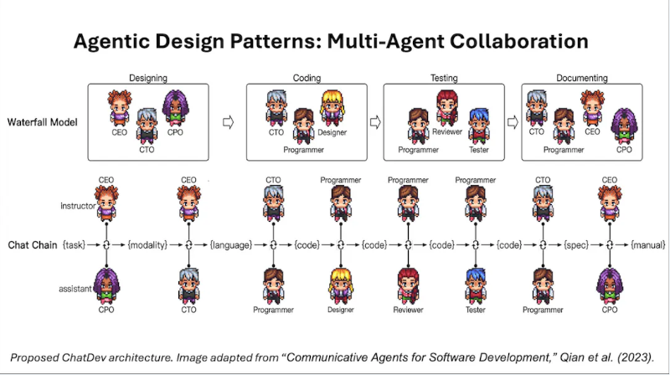
Future of AI

Slide 21
Coffee Break
3:00 PM - 3:15 PM

Slide 22

Interactive Q&A

